Slide 1
medieval village | settle | famine
(hundred) court | landlord, earl | to consult
blacksmith | villager | decision
priest | harvest | healer
tailor | starving | miller
peasant | reason | joiner
baker | member | widow

Slide 2
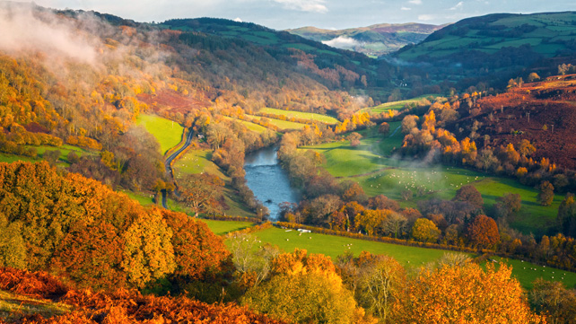
The River Wye from the village

Slide 3
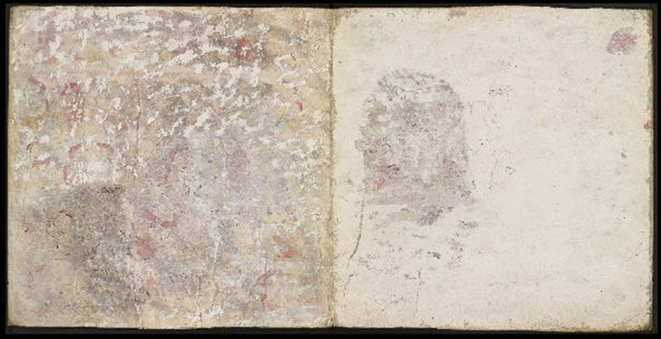
23rd paragraph:
The Earl will consult the Hundred Court before decisions of great importance.
25th paragraph:
The Hundred Court can only question the Earl’s rulings if they have a better alternative for dealing with the problem at hand.
24th paragraph:
If the Earl makes new laws without consulting the Hundred Court, the court can question the new law.

Slide 4
23rd paragraph: The Earl will consult the Hundred Court before decisions of great importance.
24th paragraph: If the Earl makes new laws without consulting the Hundred Court, the court can question the new law.
25th paragraph: The Hundred Court can only question the Earl’s rulings if they have a better alternative for dealing with the problem at hand.

